Slide 1
Cabernet: Vehicular Content Delivery Using WiFi By: Jakob Eriksson, Hari Balakrishnan, Samuel Madden
Presented by : Rajib Dey

Slide 2
Introduction
What is Cabernet ?
Cabernet has two components:
QuickWiFi: reduces connection establishment time
CTP is a transport protocol that increases the throughput than TCP
Primary Goal: Allow Moving cars to obtain high data transfer rate

Slide 3
Background and Need
Generally, moving cars transfer data using cellular data networks such as GPRS, 3G, EVDO, etc. These services can cost tens of dollars per month.
For moving vehicles, Stock implementations of wireless networking protocols are not well suited.
Cabernet takes no assumptions about drivers’ other data services, and requires no prior configuration.
With the increase of public WiFi Cabernet is likely to be sufficient for many applications.

Slide 4
Cabernet Techniques
Three Techniques
Use QuickWiFi to streamline the process
Use Cabernet Transport Protocol (CTP) to improve end-to-end throughput over lossy wireless links.
To improve link rates, adopt a static 11 Mbit/s Wi-Fi bit-rate for transfers from the car

Slide 5
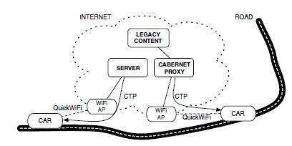
Experimental Setup
System deployed on a fleet of 10 taxis running in the Boston area.
Successfully transferred data using 26000 open APs.
Software running on embedded computer uses QuickWiFi to connect quickly, and uses CTP to deliver data .

Slide 6
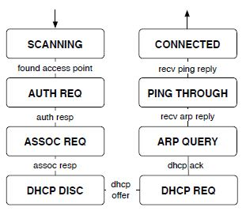
Design Overview and Goals
At high level, Cabernet’s has three objectives:
Establish connectivity quickly to take advantage of brief connection opportunities.
Handle Non-Congestion WiFi Losses
Managing Intermittent Connectivity
Fig 2: The connection establishment process

Slide 7
QuickWiFi Operation
QuickWiFi attempts to associate with the first open access point as it scans through the wireless channels. After connection is complete, it resumes scanning at the point where it left off.
Timeouts reduced to hundreds of milliseconds, rather than seconds.
Open APs require clients to authenticate, since this is always successful. There is no need to wait for the response.
To monitor and report the status of an end-to-end connection, 2 new features are introduced:
Ping-through
Connection loss monitoring

Slide 8
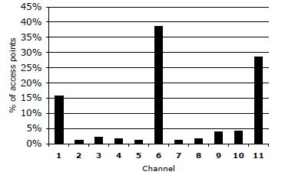
QuickWiFi Operation
83% of unique access points are assigned to non overlapping channels 1,6 and 11
This info is used to find optimal channel scanning strategy
6,11,9,2,6,1,11,10,6,3,1,11,6,4,9,11,6,1,5,10,6,11,7,1,8 provides about 40% better performance
Fig: Distribution of APs across Channels

Slide 9
Cabernet Transport Protocol
Cabernet uses proxy to mediate between unmodified Internet hosts and the node in the car. This shields the car’s intermittent connectivity and changing IP address from legacy hosts.
CTP vs TCP socket: CTP session does not break when underlying IP address changes or path disappears. Instead, hosts carry unique network-independent identifiers, allowing CTP sessions to migrate seamlessly across changing IP addresses and APs.
Improves throughput by reacting to congestive losses.
To detect congestion on the wired part, The CTP sender transmits probe packets periodically to the AP. No response signifies congestion.

Slide 10
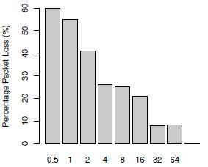
Cabernet Transport Protocol
CTP sender increases its rate after every ACK.
Rate ← rate + [ack interval/(RTT*RTT) ].
CTP reduces its rate after a new probe packet is sent. If no response, the new rate is
rate←max(rate ・ (1−c ・ ploss), rmin),
Avg. packet losses vs. encounter duration

Slide 11
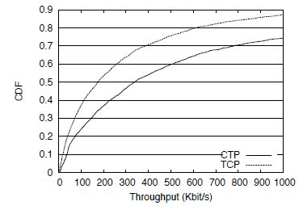
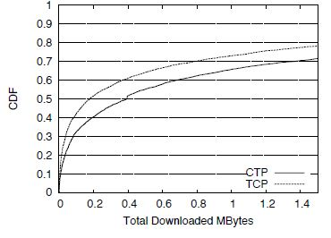
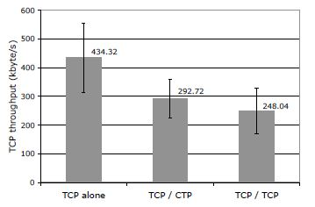
CTP vs TCP Performance
CTP is able to achieve double the throughput than TCP, with mean throughput of 800 kbit/s when connectivity is present.
Mean throughput achieved by TCP in 3 scenario
Figure : CDF of encounter-averaged throughput achieved using
CTP and TCP respectively.

Slide 12
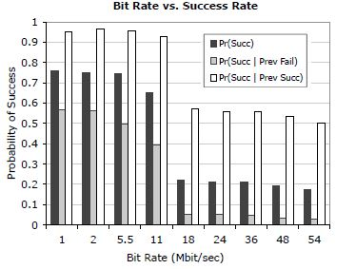
Further experimentation
Cabernet currently achieves 11 Mbit/s rate
An external antenna can improve signal quality by about 10 dBi.
Figure: Probability of a successful packet transmission, for
varying transmission rates.

Slide 13
Conclusion
QuickWiFi, is able to connect in 366 ms on average, reducing connection establishment time
CTP is able to achieve double the throughput of TCP ( Mean 800kbit/s)
Cabernet is able to achieve an end-to-end throughput of 38 MB/hour
Alongside private access points, emerging wireless mesh networks and available large-scale WiFi networks allows Cabernet to be deployed in a wider area

Slide 14
Scope of Future Improvement
Cache historical AP connectivity information so that APs with better connectivity are selected with higher probability could lead to better performance.
Standard deviation is lower when the measured TCP flow is competing with CTP than when another TCP flow. More extensive study of CTP interactions with TCP is required.
Fon’s model: users open their access point to all Fon users that also open theirs is becoming popular, and now supported by established ISPs. Incorporation of this model is important for wider deployment of Cabernet.

Slide 15
Q & A

